Slide 1

Project 1 – Housing Price Predictions
Created and Presented by:
Group1(Madeeha, Faisal, Dele)

Slide 2

Table of contents
Introduction
Research questions (hypothesis format)
Findings with graphing
Analysis
Results and conclusion

Slide 3

Introduction
1. Objective: Predict house prices based on location, year built, and other property features.
1
2. Data: Analyze housing data including Location, YearBuilt, and Price.
2
3. Grouping: Group data by Location and YearBuilt to find average prices.
3
4. Feature Engineering: Create new features like total rooms and property size to enhance prediction.
4
5. Model: Train a Linear Regression model to predict house prices using key features.
5
6. Prediction: Use the trained model to forecast house prices based on new property data.
6

Slide 4

Limitations of Data
1. Limited Features: Lacks key factors like proximity to amenities or crime rates.
2. Outdated Data: May not reflect current market trends.
3. Missing Data: Missing values can reduce model accuracy.
4. Regional Bias: Data may be skewed toward specific locations.
5. Multicollinearity: Correlated features could affect model performance.
6. Wide Year Range: Comparing homes across different eras may be challenging.

Slide 5
Hypothesis Testing
If houses located in downtown areas, then they will generally have higher prices compared to suburban areas .
If the number of floors in a house increase, then the price will also increase .
If the location of the house is determined, then the price will be affected
If the number of bedroom relevant to the number of bathrooms increases, then the price of the house will increase
If the house was built with a garage, then the price will increase

Slide 6

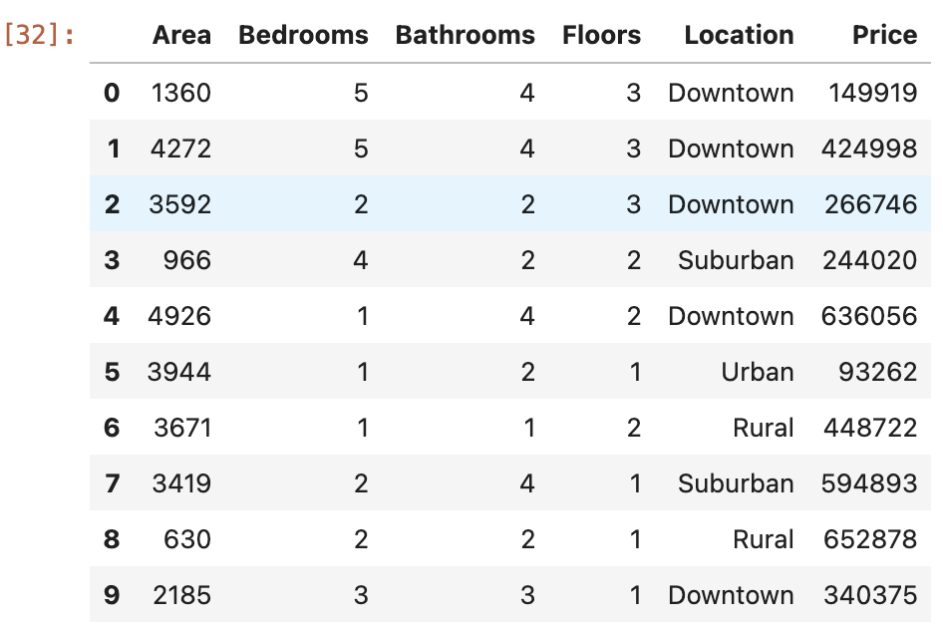
Refinement of Data frame

Slide 7

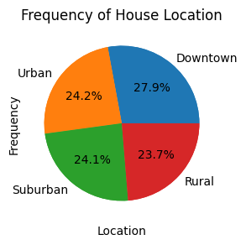
Percentage of houses in each location
Downtown 27.90%
Rural 23.70%
Suburban 24.15%
Urban 24.25%

Slide 8

Frequency of house conditions

Slide 9
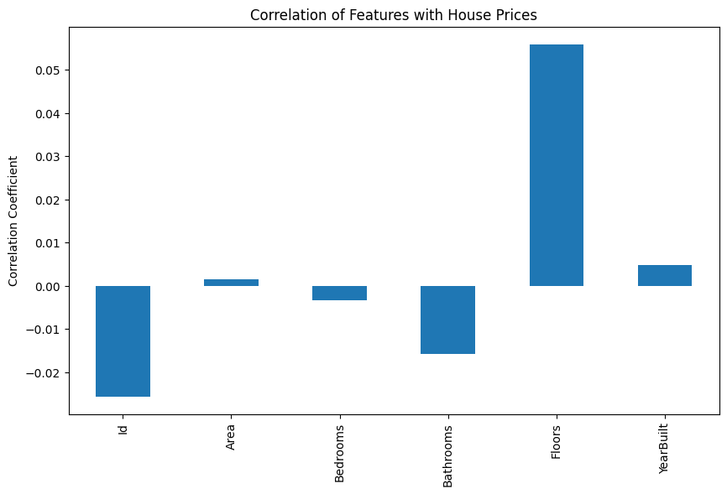
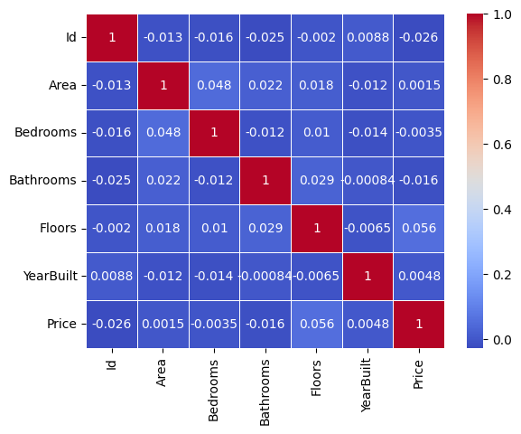
What are the key factors that influence house prices the most? How do the number of floors in a house correlate with its price?

Slide 10
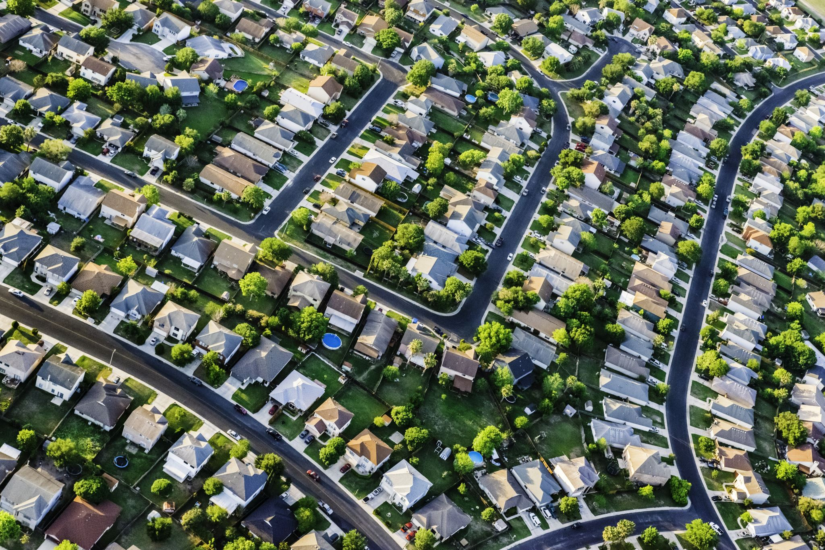
How does the location impact the mean house prices?
Location:
Downtown 536059.66
Rural 538613.94
Suburban 557416.33
Urban 518963.55

Slide 11

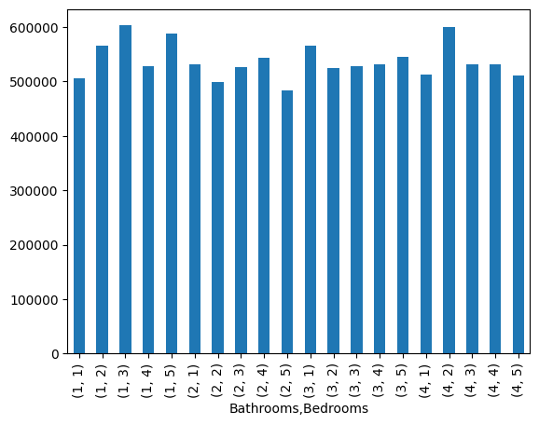
What is the relationship between the number of bedrooms and bathrooms and the house price?

Slide 12
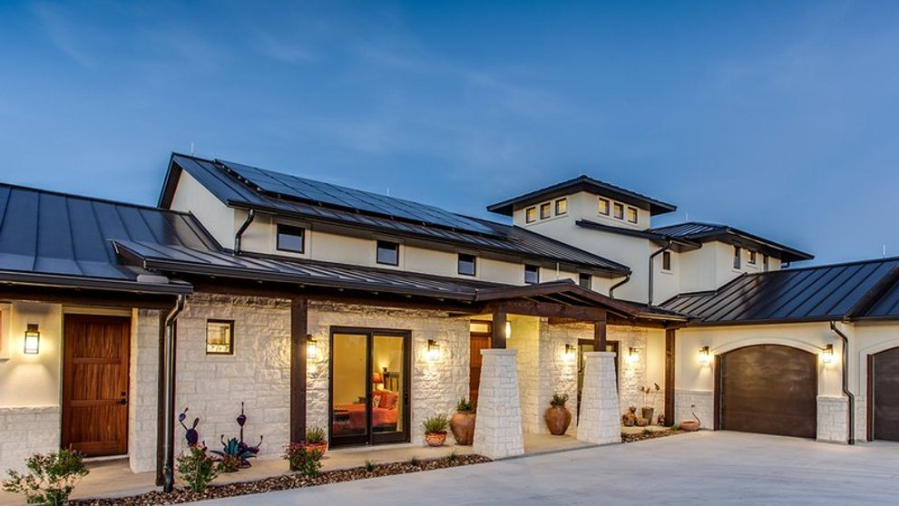
Is there a significant price difference between the mean price of houses with garages versus those without?
Garage present | Price
No | 536920.70
Yes | 538492.75
Percentage Difference | 0.29%

Slide 13

Can we have one volunteer please?

Slide 14

Thank you for your time!
Any Questions?

